Slide 1



TEAM NAME : APNI CAR
1

Slide 2

HACKER LOG
Members Name :
Member 1 ABHISHEK BHALSE
Member 2 KOMAL VERMA
Member 3 HARSHITA MUNJAL
2

Slide 3

How we can have a rental car?
At present the online platform to rent a car is limited. So we solved the problem by creating an online interface using smart contract that could solve this problem.
We created a website named as "Apni Car" which will keep a regular track over the car rented by people linked with the Tezos Smart Explorer.
It will keep the record of the car through its unique id and model. It will provide the user with the information about the car rental system which will include the information of add car, remove car, rent car and cancel reservation. It will also store the previous data which cannot be changed due to blockchain security feature.
3

Slide 4
Your Solution / Product / Services
01
We have created a car rental application that will allow user to rent car, add car to reservation, remove car and cancel reservation.
02
We have built an online interface Apni Car which will allow user to rent car online in a feasible manner. User will get real life track of the previous data. The previous data cannot be changed due to the security feature of blockchain.
First we created smart contract using smartPY. There we defined the data structures like car details and implemented the necessary functions. Then we deployed our smart contract with the help of Ghostnet network. We created our web page and wrote the react js code in VS code. Then we linked our web page to Taquito and created our final frontend.
03
4

Slide 5








Product Demo
First we created smart contract using smartPY. There we defined the data structures like car details and implemented the necessary functions. Then we deployed our smart contract with the help of Ghostnet network. We created our web page and wrote the react js code in VS code. Then we linked our web page to Taquito and created our final frontend.
5

Slide 6
TECHNOLOGIES USED
SmartPY
Python
HTML
CSS
Java Script
React Js
6

Slide 7
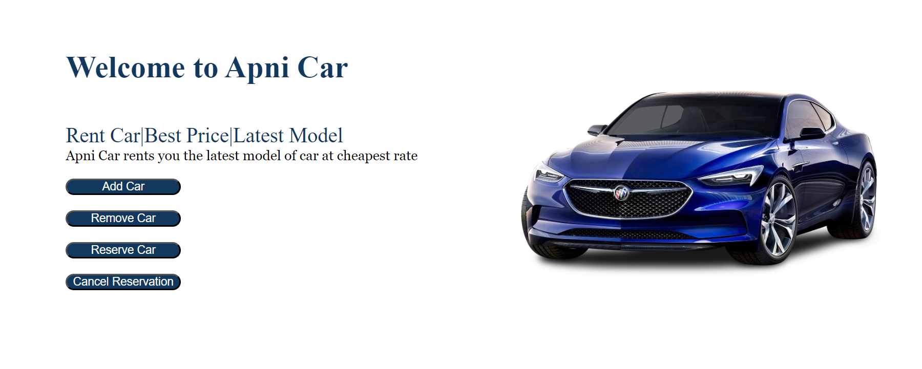
User Interface
c
6

Slide 8
Functioning of Apni Car
Add Car : User can register their car for renting.
Remove car : User can remove their registered car.
Reserve car : User can book a Rental Car
Cancel Reservation : User can cancel the reserved booking
6

Slide 9
Important Links
Smart Contract : KT1M6C1CvfFqFoaY3C1VQgB7YmB85BS7VRJB
github:
https://github.com/Abhishek282004/ApniCar
HTML/CSS (User Interface):
https://github.com/Abhishek282004/HTML-CSS-User-Interface-

